Slide 1

Module 4
Asymmetric-Key
Cryptography
Copyright © The McGraw-Hill Companies, Inc. Permission required for reproduction or display.
10.<number>

Slide 2
10-1 INTRODUCTION
Symmetric and asymmetric-key cryptography will exist in parallel and continue to serve the community. We actually believe that they are complements of each other; the advantages of one can compensate for the disadvantages of the other.
Topics discussed in this section:
Keys
General Idea
Need for Both
Trapdoor One-Way Function
10.<number>

Slide 3

10-1 INTRODUCTION
Symmetric and asymmetric-key cryptography will exist in parallel and continue to serve the community. We actually believe that they are complements of each other; the advantages of one can compensate for the disadvantages of the other.
Note
Symmetric-key cryptography is based on sharing secrecy;
asymmetric-key cryptography is based on personal secrecy.
10.<number>

Slide 4
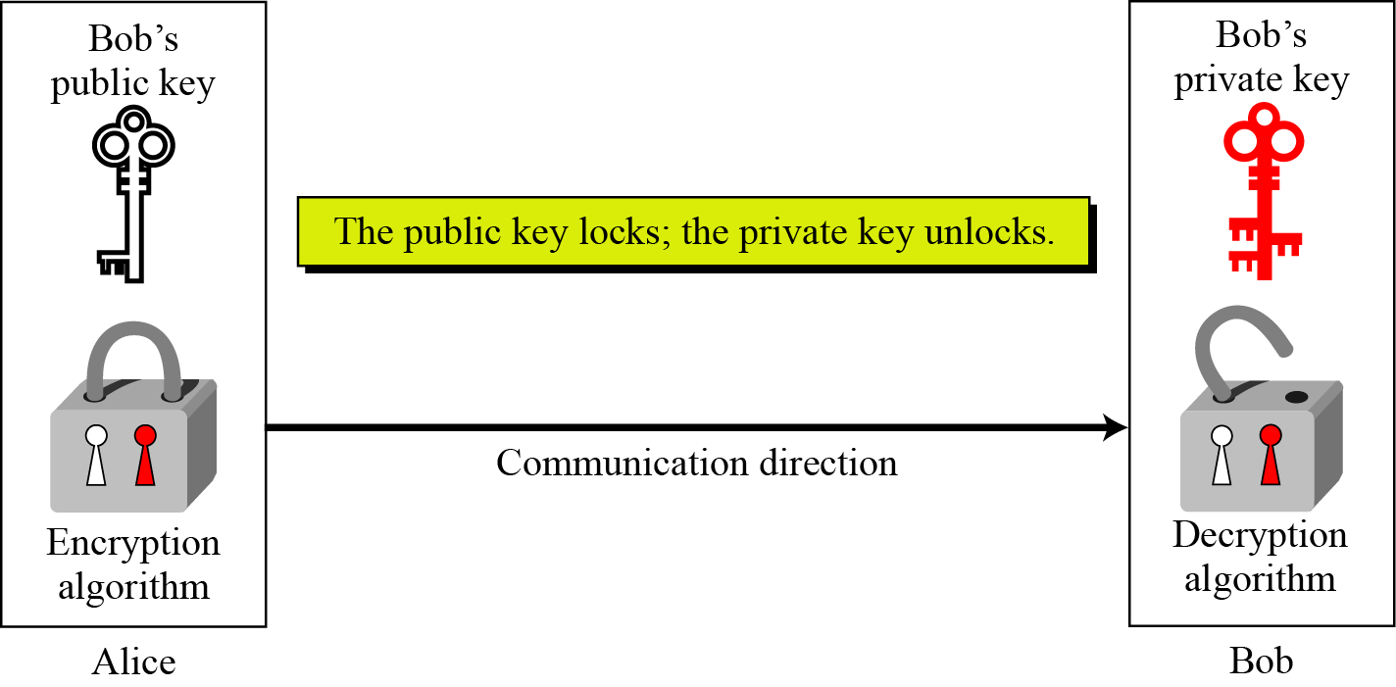
10.1.1 Keys
Asymmetric key cryptography uses two separate keys: one private and one public.
Figure 10.1 Locking and unlocking in asymmetric-key cryptosystem
10.<number>

Slide 5
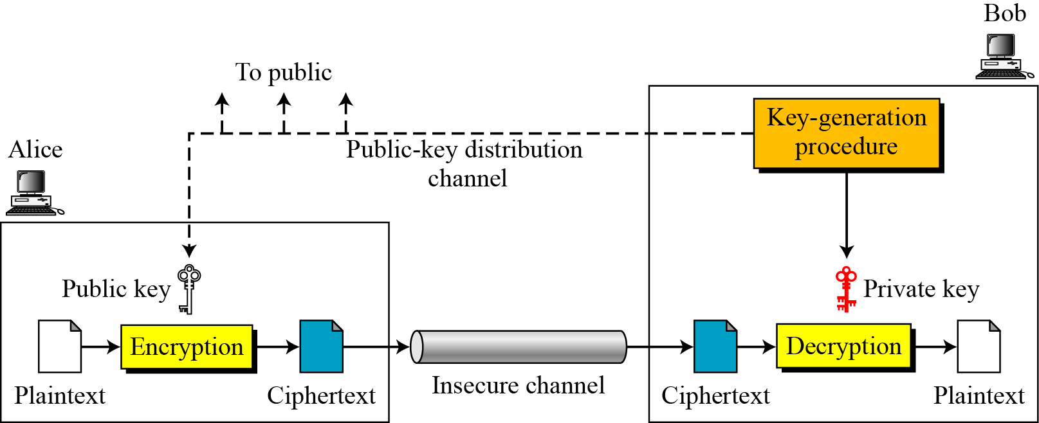
10.1.2 General Idea
Figure 10.2 General idea of asymmetric-key cryptosystem
10.<number>

Slide 6
10.1.2 Continued
Plaintext/Ciphertext
Unlike in symmetric-key cryptography, plaintext and ciphertext are treated as integers in asymmetric-key cryptography.
Encryption/Decryption
C = f (K_{public} , P) P = g(K_{private} , C)
10.<number>

Slide 7
10.1.3 Need for Both
There is a very important fact that is sometimes misunderstood: The advent of asymmetric-key cryptography does not eliminate the need for symmetric-key cryptography.
10.<number>

Slide 8
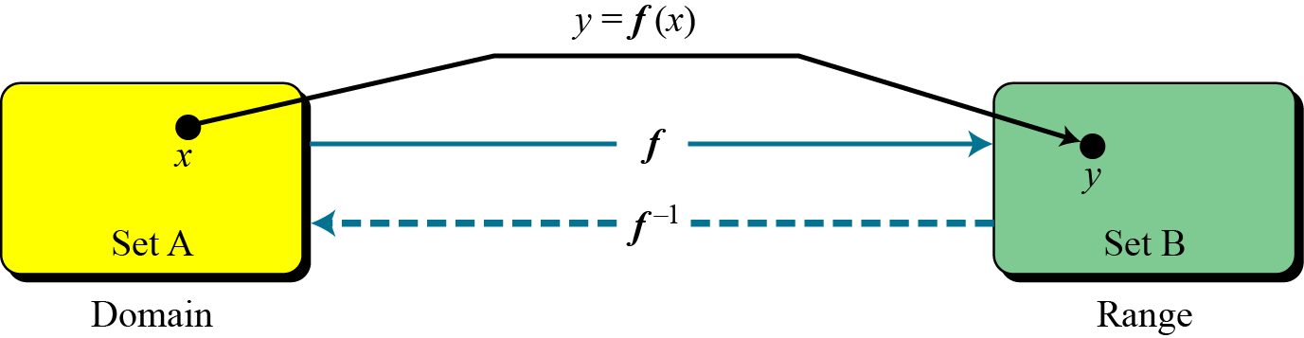
10.1.4 Trapdoor One-Way Function
The main idea behind asymmetric-key cryptography is the concept of the trapdoor one-way function.
Rule that maps one element in set A to one element in set B
Invertible function associates each element in range with exactly one element in domain.
Functions
Figure 10.3 A function as rule mapping a domain to a range
10.<number>

Slide 9
One-way Function
Satisfies two properties
  f is easy to compute. Given x, y=f(x) can be easily computed
  f⁻¹ is difficult to compute. Given y, it is computationally infeasible to calculate x= f⁻¹(y)
Trapdoor One-way function
  3rd property
    Given y and a trapdoor (secret), x can be computed easily.

Slide 10
10.1.4 Continued
One-Way Function (OWF)
1. f is easy to compute.
2. f ⁻¹ is difficult to compute.
Trapdoor One-Way Function (TOWF)
3. Given y and a trapdoor, x can be
computed easily.
10.<number>

Slide 11
10.1.4 Continued
Example 10. 1
When n is large, n = p × q is a one-way function. Given p and q , it is always easy to calculate n ; given n, it is very difficult to compute p and q. This is the factorization problem.
Example 10. 2
When n is large, the function y = x^{k} mod n is a trapdoor one-way function. Given x, k, and n, it is easy to calculate y. Given y, k, and n, it is very difficult to calculate x. This is the discrete logarithm problem. However, if we know the trapdoor, k′ such that k × k ′ = 1 mod φ(n), we can use x = y^{k′} mod n to find x.
10.<number>

Slide 12
10-2 RSA CRYPTOSYSTEM
The most common public-key algorithm is the RSA cryptosystem, named for its inventors (Rivest, Shamir, and Adleman).
Topics discussed in this section:
Introduction
Procedure
Some Trivial Examples
Attacks on RSA
Recommendations
Applications
10.<number>

Slide 13
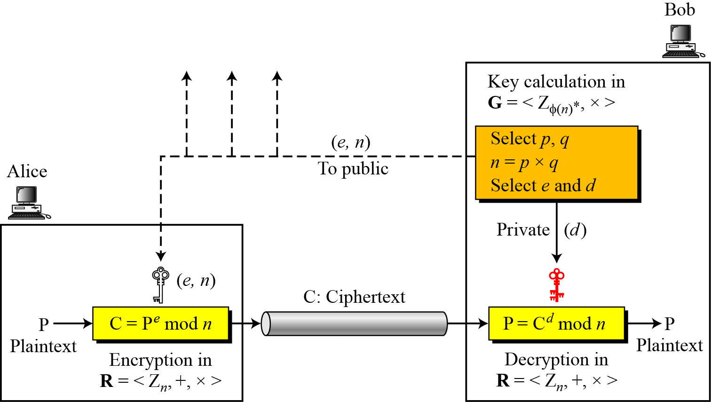
10.2.2 Procedure
Figure 10.6 Encryption, decryption, and key generation in RSA
10.<number>

Slide 14
10.2.2 Continued
Two Algebraic Structures
R = <Z_{n} , +, × >
Encryption/Decryption Ring:
Key-Generation Group:
G = <Z _{φ(n)}∗, × >
10.<number>

Slide 15
Key-generation group
RSA uses multiplicative group for key-generation
This group supports only multiplication/division (which uses multiplicative inverses) for generating public and private keys
This group is hidden from public because modulus phi(n) is hidden from public.
If Eve can find this modulus, she can attack the cryptosystem

Slide 16
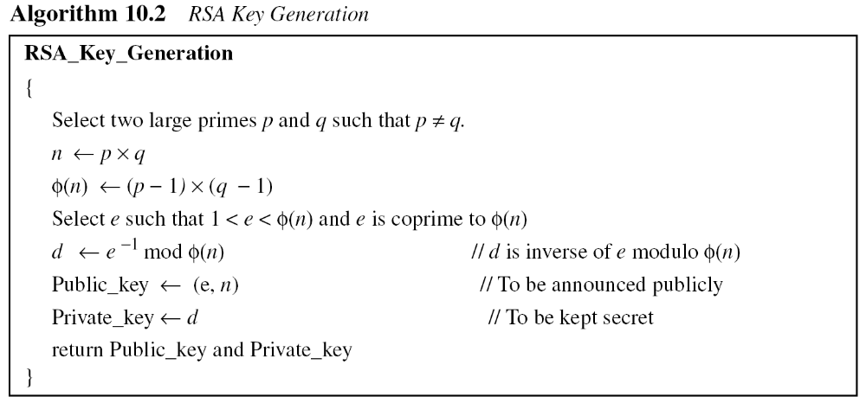
10.2.2 Continued
10.<number>

Slide 17
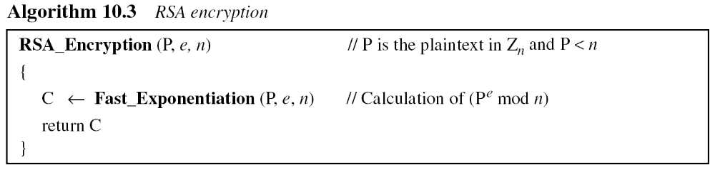
10.2.2 Continued
Encryption
10.<number>

Slide 18
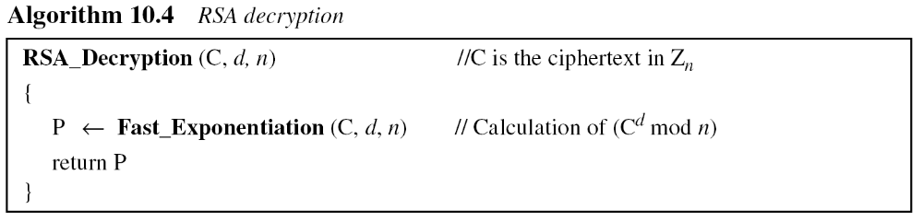
10.2.2 Continued
Decryption
10.<number>

Slide 19
10.2.3 Some Trivial Examples
Example 10. 5
Bob chooses 7 and 11 as p and q
If he chooses e to be 13, then d is ?.
Now imagine that Alice wants to send the plaintext 5 to Bob..
10.<number>

Slide 20
10.2.3 Some Trivial Examples
Example 10. 5
Bob chooses 7 and 11 as p and q and calculates n = 77. The value of φ(n) = (7 − 1)(11 − 1) or 60. Now he chooses two exponents, e and d, from Z₆₀∗. If he chooses e to be 13, then d is 37. Note that e × d mod 60 = 1 (they are inverses of each Now imagine that Alice wants to send the plaintext 5 to Bob. She uses the public exponent 13 to encrypt 5.
Bob receives the ciphertext 26 and uses the private key 37 to decipher the ciphertext:
10.<number>

Slide 21
10.2.3 Some Trivial Examples
Example 10. 5
Bob chooses 7 and 11 as p and q and calculates n = 77. The value of φ(n) = (7 − 1)(11 − 1) or 60. Now he chooses two exponents, e and d, from Z₆₀∗. If he chooses e to be 13, then d is 37. Note that e × d mod 60 = 1 (they are inverses of each Now imagine that Alice wants to send the plaintext 5 to Bob. She uses the public exponent 13 to encrypt 5.
Bob receives the ciphertext 26 and uses the private key 37 to decipher the ciphertext:
10.<number>

Slide 22
10.2.3 Some Trivial Examples
Example 10. 6
Now assume that another person, John, wants to send a message to Bob. John can use the same public key announced by Bob (probably on his website), 13; John’s plaintext is 63. John calculates the following:
10.<number>

Slide 23
10.2.3 Some Trivial Examples
Example 10. 6
Now assume that another person, John, wants to send a message to Bob. John can use the same public key announced by Bob (probably on his website), 13; John’s plaintext is 63. John calculates the following:
Bob receives the ciphertext 28 and uses his private key 37 to decipher the ciphertext:
10.<number>

Slide 24
10.2.3 Some Trivial Examples
Example 10. 7
Jennifer creates a pair of keys for herself. She chooses p = 397 and q = 401. She calculates
n = 159197. She then calculates φ(n) = 158400. She then chooses e = 343 and d = 12007. Show how Ted can send a message to Jennifer if he knows e and n.
Suppose Ted wants to send the message “NO” to Jennifer. He changes each character to a number (from 00 to 25), with each character coded as two digits. He then concatenates the two coded characters and gets a four-digit number. The plaintext is 1314. Figure 10.7 shows the process.
10.<number>

Slide 25
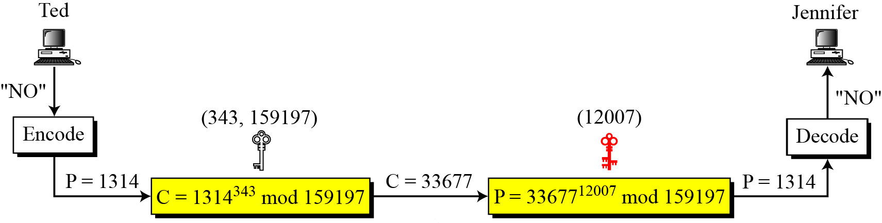
10.2.3 Continued
Figure 10.7 Encryption and decryption in Example 10.7
10.<number>

Slide 26
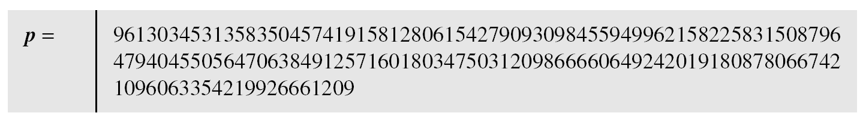
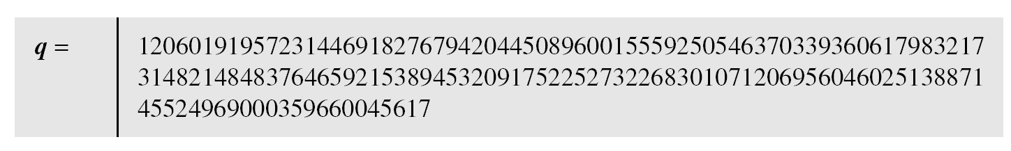
10.2.6 Continued
Example 10. 8
Here is a more realistic example. We choose a 512-bit p and q, calculate n and φ(n), then choose e and test for relative primeness with φ(n). We then calculate d. Finally, we show the results of encryption and decryption. The integer p is a 159-digit number.
10.<number>

Slide 27
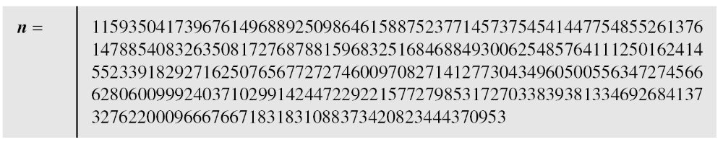
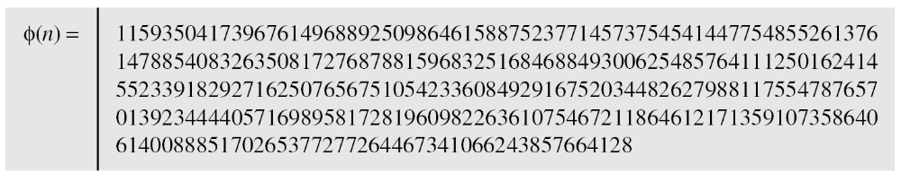
10.2.6 Continued
Example 10. 8
Continued
The modulus n = p × q. It has 309 digits.
φ(n) = (p − 1)(q − 1) has 309 digits.
10.<number>

Slide 28
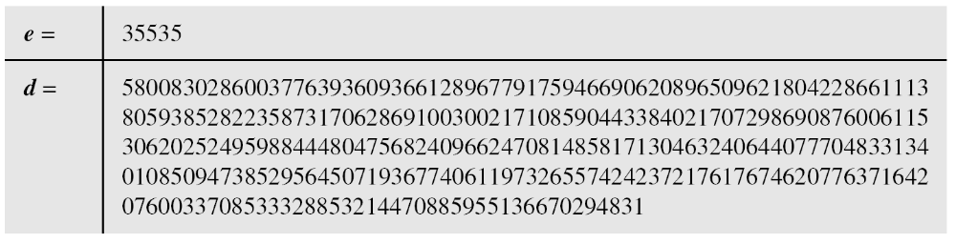
10.2.6 Continued
Example 10. 8
Continued
Bob chooses e = 35535 (the ideal is 65537) and tests it to make sure it is relatively prime with φ(n). He then finds the inverse of e modulo φ(n) and calls it d.
10.<number>

Slide 29
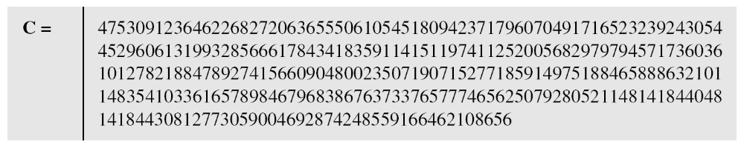
10.2.6 Continued
Example 10. 8
Continued
Alice wants to send the message “THIS IS A TEST”, which can be changed to a numeric value using the 00−26 encoding scheme (26 is the space character).
The ciphertext calculated by Alice is C = P^{e}, which is
10.<number>

Slide 30
10.2.6 Continued
Example 10. 8
Continued
Bob can recover the plaintext from the ciphertext using P = C^{d}, which is
The recovered plaintext is “THIS IS A TEST” after decoding.
10.<number>

Slide 31
Factorization - Attack
The security of RSA is based on the fact that modulus is so large that it is infeasible to factor it in reasonable time.
To be secure, RSA requires that n will be 300 decimal digits, then modulus must be at least 1024 digits.
No factorization algorithm till date can factorize such a large number in reasonable amount of time.

Slide 32
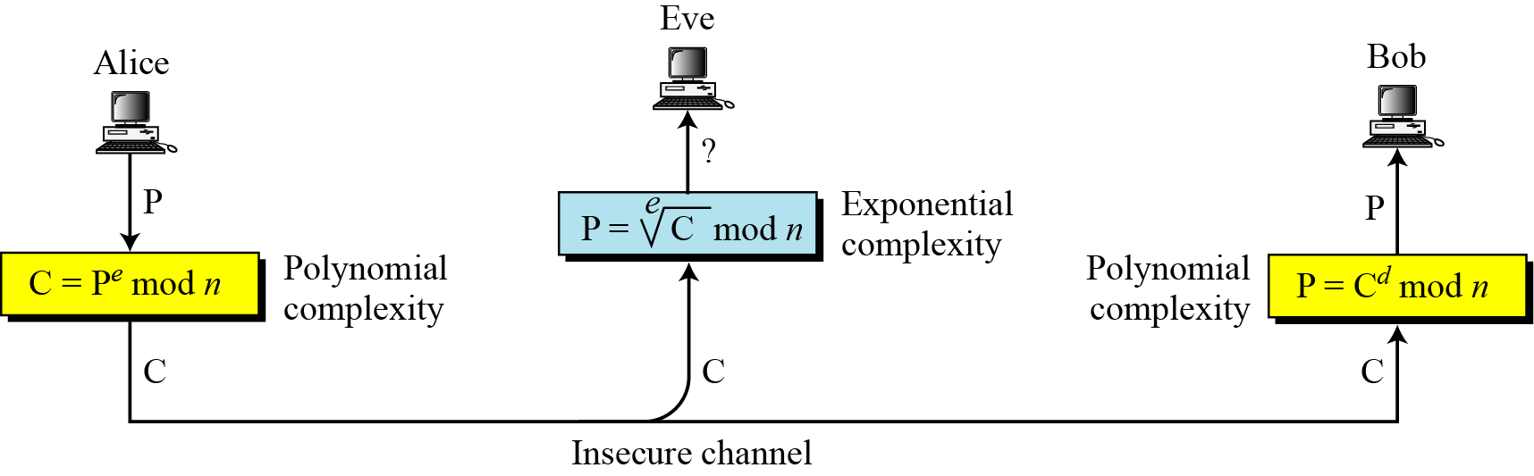
10.2.1 Introduction
Figure 10.5 Complexity of operations in RSA
10.<number>

Slide 33
Recommendations
Number of bits for n should be atleast 1024. n should be around 2¹⁰²⁴ or 309 decimal digits.
p and q must each be atleast 512 digits. p and q should be around 2⁵¹² or 154 decimal digits.
p and q should not be very close to each other.
Both p-1 and q-1 should have at least one large prime factor.
Ratio p/q should not be close to rational number with small numerator or denominator.
Modulus n must not be shared

Slide 34
Recommendations contd..
Value of e should be 2¹⁶ + 1 or an integer close to this value.
If private key d is leaked, Bob must immediately change n as well as both e and d.

Slide 35
10-4 ELGAMAL CRYPTOSYSTEM
Besides RSA, another public-key cryptosystem is ElGamal. ElGamal is based on the discrete logarithm problem.
Topics discussed in this section:
10.4.1 ElGamal Cryptosystem
10.4.2 Procedure
10.4.3 Proof
10.4.4 Analysis
10.4.5 Security of ElGamal
10.4.6 Application
10.<number>

Slide 36
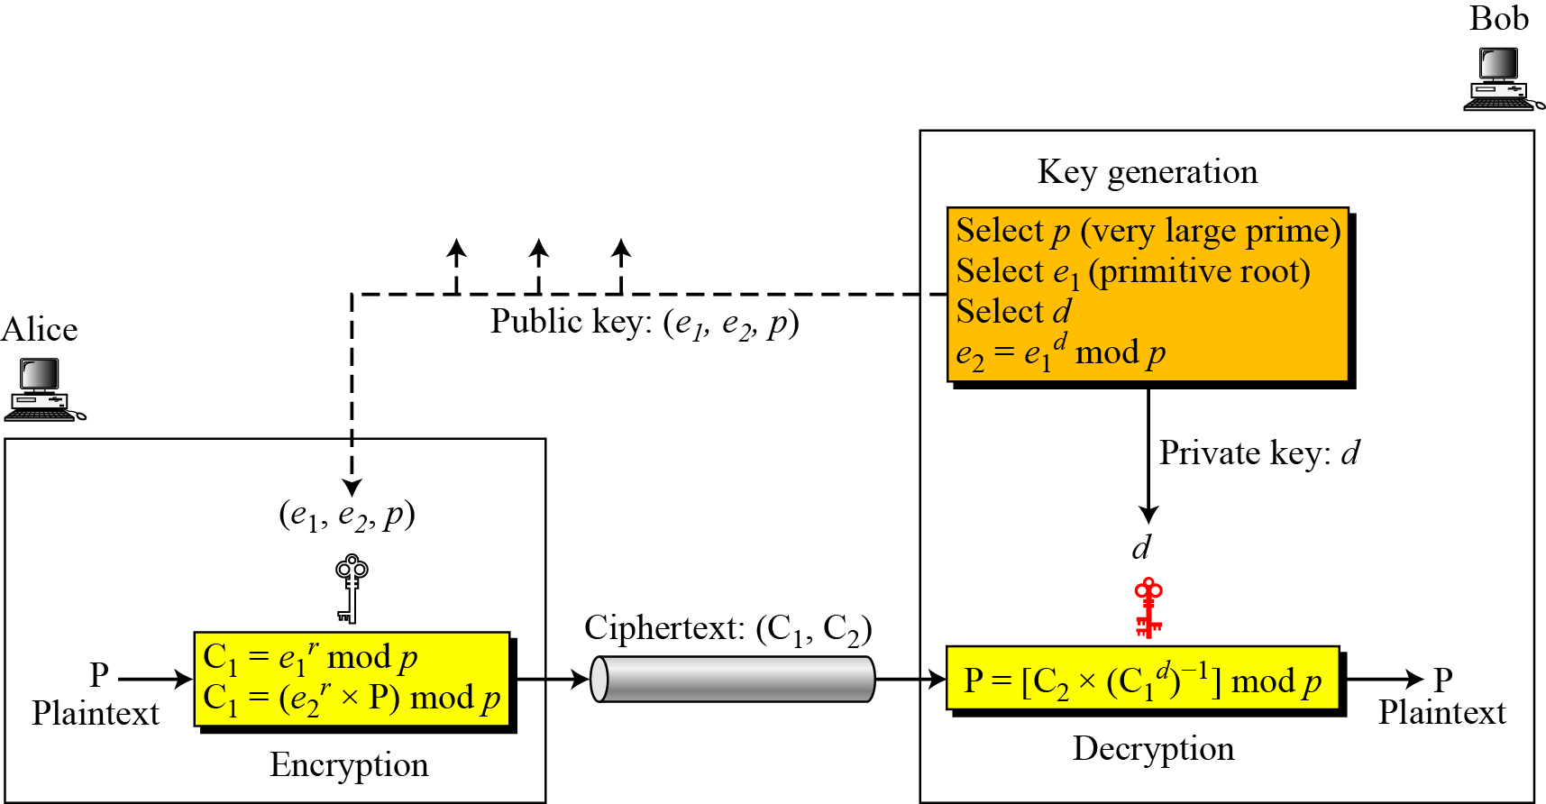
10.4.2 Procedure
Figure 10.11 Key generation, encryption, and decryption in ElGamal
10.<number>

Slide 37
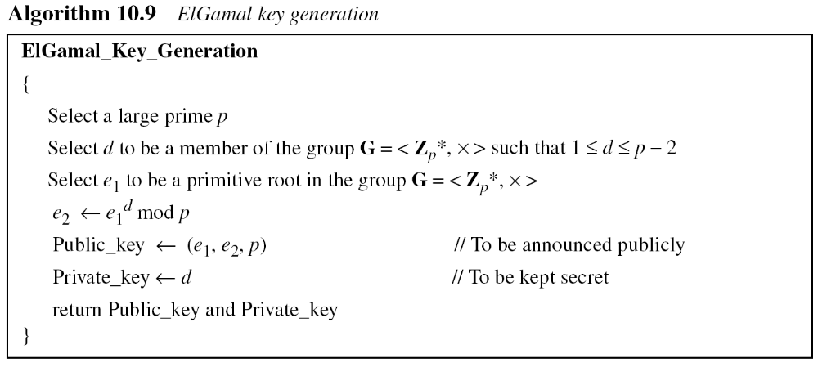
10.4.2 Continued
Key Generation
10.<number>

Slide 38
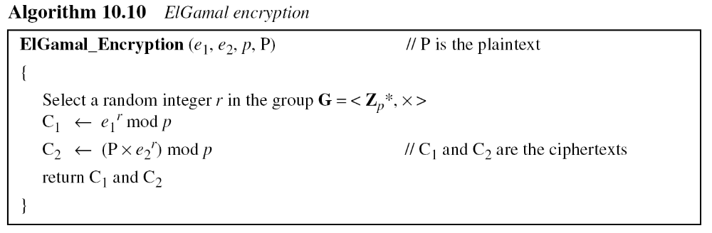
10.4.2 Continued
10.<number>

Slide 39
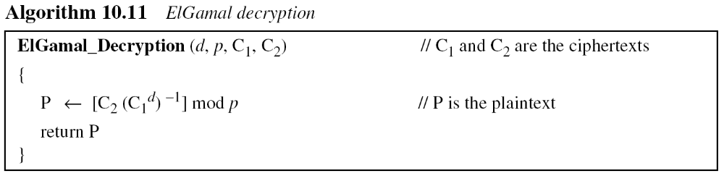
10.4.2 Continued
Note
The bit-operation complexity of encryption or decryption in ElGamal cryptosystem is polynomial.
10.<number>

Slide 40
Proof
The ElGamal decryption expression C2 × (C1^{d})⁻¹ can be verified to be P through substitution
10.<number>

Slide 41
10.4.3 Continued
Example 10. 10
Here is a trivial example. Bob chooses p = 11 and e₁ = ?.
and d = 3 Calculate the public keys are (e1, e2, p)?
10.<number>

Slide 42
10.4.3 Continued
Example 10. 10
Here is a trivial example. Bob chooses p = 11 and e₁ = 2.
and d = 3 Calculate the public keys are (e1, e2, p)? and the private key is 3. If Alice chooses r = 4, calculate C1 and C2 for the plaintext 7. Similarly find Plaintext by Bob
10.<number>

Slide 43
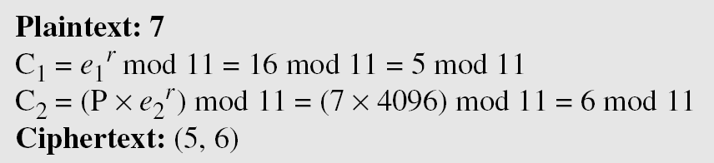
10.4.3 Continued
Example 10. 10
Here is a trivial example. Bob chooses p = 11 and e₁ = 2.
and d = 3 e₂ = e₁^{d} = 8. So the public keys are (2, 8, 11) and the private key is 3. Alice chooses r = 4 and calculates C1 and C2 for the plaintext 7.
Bob receives the ciphertexts (5 and 6) and calculates the plaintext.
10.<number>

Slide 44
10.4.3 Continued
Example 10. 11
Instead of using P = [C₂ × (C₁^{d}) ⁻¹] mod p for decryption, we can avoid the calculation of multiplicative inverse and use
P = [C₂ × C₁ ^{p−1−d}] mod p (see Fermat’s little theorem ).
we can calculate P = [6 × 5 ¹¹⁻¹⁻³] mod 11 = 7 mod 11.
Note
For the ElGamal cryptosystem, p must be at least 300 digits and r must be new for each encipherment.
10.<number>

Slide 45
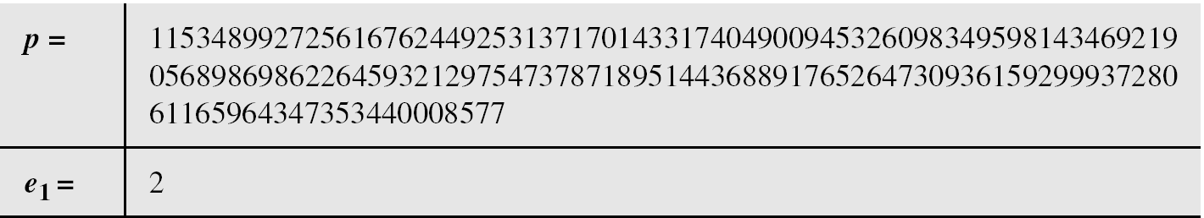
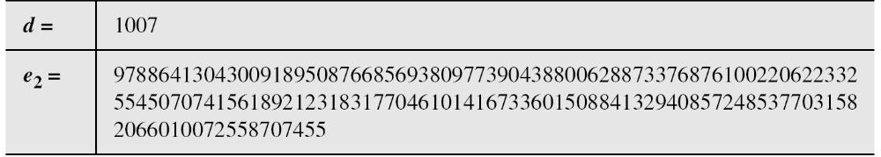
10.4.3 Continued
Example 10. 12
Bob uses a random integer of 512 bits . The integer p is a 155-digit number (the ideal is 300 digits ~ 1024 bits). Bob then chooses e₁, d, and calculates e₂, as shown below:
10.<number>

Slide 46
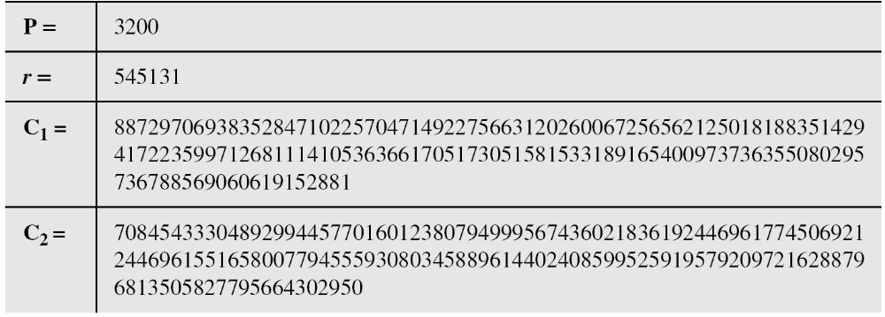
10.4.3 Continued
Example 10. 10
Alice has the plaintext P = 3200 to send to Bob. She chooses
r = 545131, calculates C1 and C2, and sends them to Bob.
Bob calculates the plaintext P = C₂ × ((C₁)^{d})⁻¹ mod p = 3200 mod p.
10.<number>

